Slide 1

AGE 310: Instrumentation and Measurements
Lecture 9: Data Communication & Protocols
Instructor: Dr. Kadeghe Fue
Department of Agricultural Engineering
Sokoine University of Agriculture (SUA)

Slide 2


Recap & Objectives
Recap: Lecture 8
Lecture 9 Objectives
We introduced Digital Logic (Gates) and Microcontrollers (Arduino). We learned how to read sensors and drive actuators using digital/analog I/O.
Differentiate Parallel vs. Serial transmission.
Master standard protocols: UART, I2C, SPI.
Understand the Agricultural Standard: CAN Bus and ISOBUS.
Explore Wireless Telemetry: LoRaWAN and IoT.

Slide 3

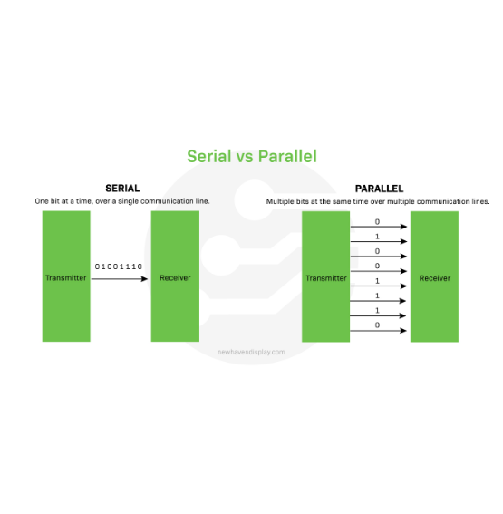
Data Transmission: The Highway Analogy
Parallel Transmission
Multiple bits are sent simultaneously over multiple wires (like an 8-lane highway).
Pros: Fast.
Cons: Expensive cabling, limited distance (crosstalk), bulky connectors.
Serial Transmission
Bits are sent one by one over a single wire (like a single-lane road).
Pros: Cheap, long-distance, simple wiring.
Almost all modern sensors use Serial.

Slide 4






Synchronous vs. Asynchronous
How does the receiver know when to read a bit?
Synchronous
Asynchronous
Uses a separate Clock Line (CLK).
No Clock line.
The Master sends a pulse for every bit. "Read now... Read now..."
Both sides must agree on a speed (Baud Rate) beforehand.
Examples: I2C, SPI.
Example: UART (Serial Monitor).

Slide 5


1. UART (Serial)
Universal Asynchronous Receiver-Transmitter
The most basic communication.
Wires: 2 (TX -> RX, RX -> TX).
Speed: Low (9600 baud common).
Topology: Point-to-Point (1 Master, 1 Slave).
Ag Use: GPS modules (NMEA data), GSM modems.

Slide 6
2. I2C (Inter-Integrated Circuit)
The "Two-Wire" Interface
Key Features
SDA (Data): Bi-directional data line.
Addressable: Each sensor has a unique ID (e.g., 0x68). You can connect 100+ sensors to the SAME two wires.
SCL (Clock): Synchronizes the data.
Ag Use: Connecting Temp, Humidity, and Pressure sensors to one Arduino.

Slide 7

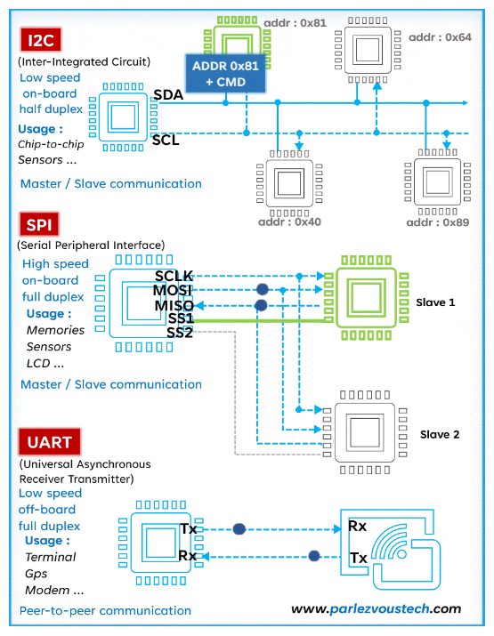
3. SPI (Serial Peripheral Interface)
The "Speed King"
Uses 4 wires: MOSI, MISO, SCK, SS.
Full Duplex: Can send and receive at the same time.
High Speed: MHz range (much faster than I2C).
Ag Use: SD Card logging, TFT Displays, Ethernet modules.

Slide 8
Protocol Comparison
Feature | UART | I2C | SPI
Wires | 2 (TX, RX) | 2 (SDA, SCL) | 4 (MOSI, MISO, SCK, CS)
Speed | Slow | Medium | Fast
Devices | 1 to 1 | 127+ (Addressed) | Multiple (Chip Select)
Complexity | Simple | Medium | Complex

Slide 9
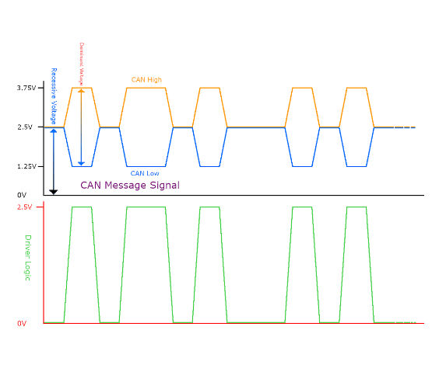
The Agricultural Standard: CAN Bus
Controller Area Network
Developed by Bosch for cars, adopted by Tractors (J1939).
Why CAN?
Differential Signal: Uses CAN_H and CAN_L wires. If noise hits, it affects both equally, so the difference remains the same. (High Noise Immunity).
Robust: Works in hot, dirty, vibrating engines.

Slide 10
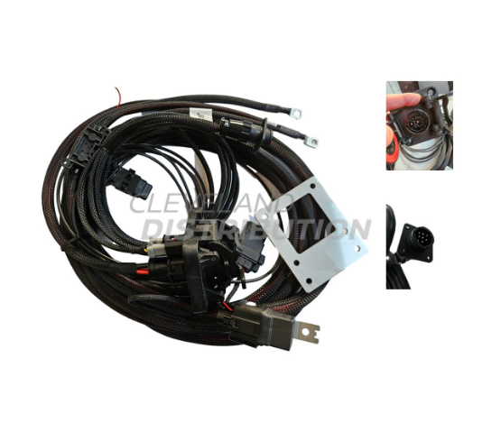
ISOBUS (ISO 11783)
Plug and Play Farming
Before ISOBUS, every implement needed its own screen in the cab.
The Standard: Allows a John Deere tractor to talk to a Kuhn sprayer using a single cable and a single terminal (Virtual Terminal).
Based on CAN Bus protocol.

Slide 11






Wireless Telemetry
Bluetooth
Wi-Fi
Cellular (GSM/4G)
Short range (10m). Low power.
Medium range (100m). High data rate.
Global range. Requires SIM card.
Use: Configuring sensors via Smartphone App in the field.
Use: Remote weather stations sending data to the Cloud.
Use: Farm office/Greenhouse automation where power is available.

Slide 12
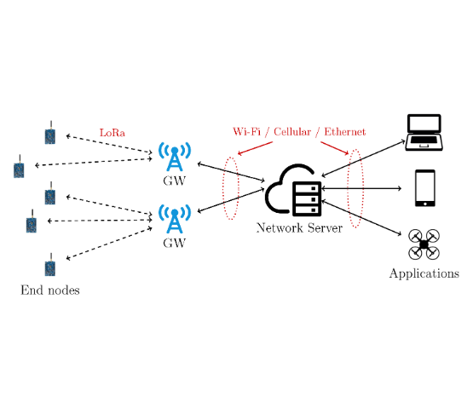
Long Range Low Power: LoRaWAN
The Future of Smart Farming
LoRa (Long Range): Can transmit 10-15 km in rural areas.
Low Power: Sensors run on batteries for years.
Architecture: End Nodes (Sensors) → Gateway (Farm Office) → Cloud (Internet).

Slide 13
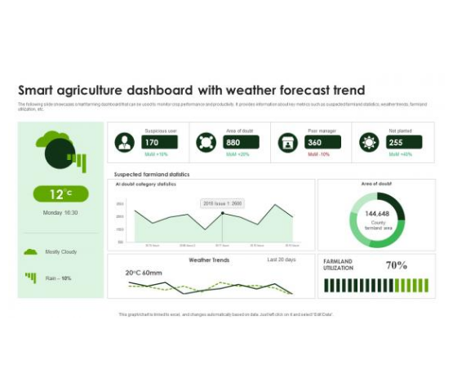
Real World App: IoT Dashboard
Making Data Useful
All these protocols lead to one goal: Decision Support.
Data arrives in the cloud and is visualized on a dashboard.
Real-time graphs of soil moisture.
Alerts (SMS) if temperature freezes.
Historical trends for crop planning.

Slide 14

Summary
1. Serial is the standard for data transmission.
2. I2C connects sensors; SPI connects displays/SD cards.
3. CAN Bus is the nervous system of modern tractors.
4. LoRaWAN connects the entire farm.

Slide 15

Questions?
End of Lecture 9
Assignment: Research "NMEA 0183" sentences used by GPS. Decode the sentence: $GPGGA,123519,4807.038,N,01131.000,E,1,08,0.9,545.4,M,46.9,M,,*47
Dr. Kadeghe Fue | AGE 310 | SUA

